Slide 1
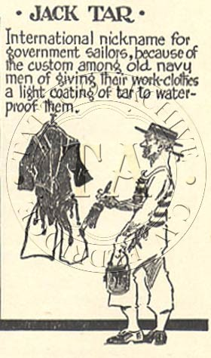
TARR
Mr. Tarr
Comes from Bristol as an occupational surname. It refers to somebody who worked with tar or bitumen in waterproofing ships.
Notes:
SAMPLE

Slide 2
[Surname]
The name goes here
[explain the origin of the surname in this box]
Paste an appropriate image in this box so that it fills the space.

Slide 3
[Surname]
The name goes here
[explain the origin of the surname in this box]
Paste an appropriate image in this box so that it fills the space.

Slide 4
[Surname]
The name goes here
[explain the origin of the surname in this box]
Paste an appropriate image in this box so that it fills the space.

Slide 5
[Surname]
The name goes here
[explain the origin of the surname in this box]
Paste an appropriate image in this box so that it fills the space.

Slide 6
[Surname]
The name goes here
[explain the origin of the surname in this box]
Paste an appropriate image in this box so that it fills the space.

Slide 7
[Surname]
The name goes here
[explain the origin of the surname in this box]
Paste an appropriate image in this box so that it fills the space.

Slide 8
[Surname]
The name goes here
[explain the origin of the surname in this box]
Paste an appropriate image in this box so that it fills the space.

Slide 9
[Surname]
The name goes here
[explain the origin of the surname in this box]
Paste an appropriate image in this box so that it fills the space.

Slide 10
[Surname]
The name goes here
[explain the origin of the surname in this box]
Paste an appropriate image in this box so that it fills the space.

Slide 11
[Surname]
The name goes here
[explain the origin of the surname in this box]
Paste an appropriate image in this box so that it fills the space.

Slide 12
[Surname]
The name goes here
[explain the origin of the surname in this box]
Paste an appropriate image in this box so that it fills the space.

